Slide 1

MATH30
Probability and Statistics

Slide 2
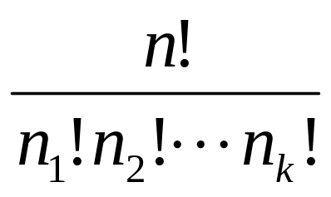
Permutation
Theorem 2.5
The number of permutations of n distinct objects arranged in a circle is (n − 1)!.
Theorem 2.6
The number of distinct permutations of n things of which n₁ are of one kind, n₂ of a second kind,…, n_{k} of a kth kind is

Slide 3
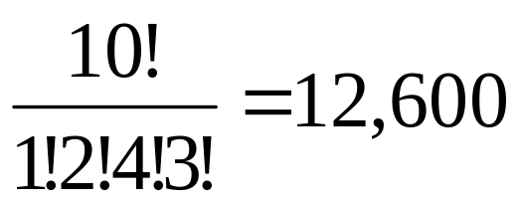
Permutation
Example 2.19
In a college football training session, the defensive coordinator needs to have 10 players standing in a row. Among these 10 players, there are 1 freshman, 2 sophomore, 4 juniors and 3 seniors, respectively. How many different ways can they be arranged in a row if only their class level will be distinguished?
Solution:

Slide 4
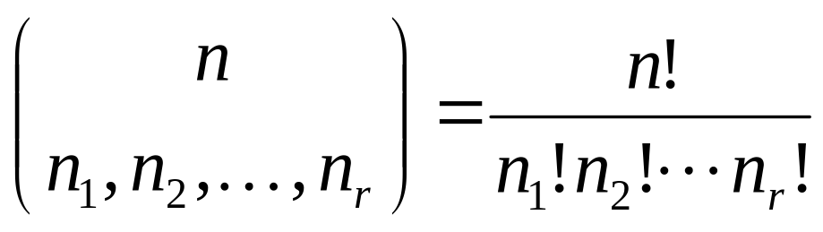
Permutation
Theorem 2.7
The number of ways of partitioning a set of n objects into r cells with n₁ elements in the first cell, n₂ elements in the second, and so forth, is
where n₁ + n₂ + … + n_{r} = n

Slide 5
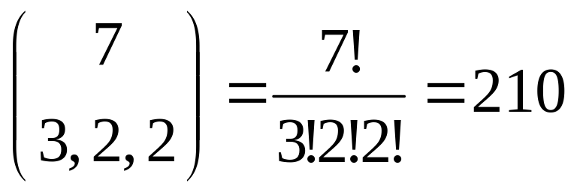
Permutation
Example 2.20
In how many ways can 7 scientists be assigned to one triple and two double hotel rooms?
Solution:

Slide 6
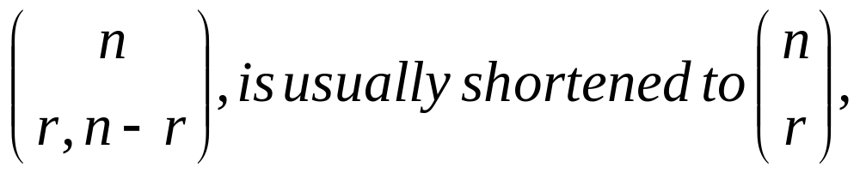
Combination
A combination is actually a partition of two cells, the one cell containing the r objects selected and the other cell containing the (n − r) objects that are left.
The number of such combinations, denoted by
since the number of elements in the second cell must be n − r.

Slide 7
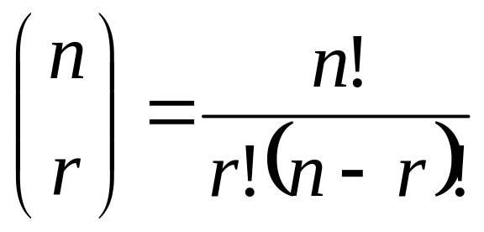
Combination
Theorem 2,8
The number of combinations of n distinct objects taken r at a time is

Slide 8
Combination
Example 2.21
A young boy asks his mother to get five game-boy cartridges from his collection of 10 arcade and 5 sports games. How many ways are there that his mother will get 3 arcade and 2 sports games, respectively?
Solution:
The number of ways of selecting 3 cartridges from 10 is ₁₀C₃ = 120.
The number of ways of selecting 2 cartridges from 5 is ₅C₂ = 10.
By multiplication rule, n₁n₂ = 120×10 = 1,200 ways.

